Slide 1
III Unit Root Tests
FROM: National Tsing Hua University
www.econ.nthu.edu.tw/teachers/chyi/Time/unit%20root%20test%202.ppt
Why do we need the test?
DF and ADF tests
Type I and II Errors
Other Unit Root Tests

Slide 2
Review: practical advice
First, look at the data;
Secondly, if you think there might be a trend, include a trend in the test equation
Thirdly, always include a constant.

Slide 3
Review: other tips of unit root tests
It’s useful to reverse the null (unit root) and alternative (stationary) hypotheses in some cases (KPSS test)
Other forms of nonstationarity:
  I(2)
  I(d); d is not an integer; fractionally integrated

Slide 4
4. Other Unit Root Tests: i. Phillips-Perron Test (PP)
Phillips and Perron have developed a more comprehensive theory of unit root nonstationarity. The tests are similar to ADF tests, but they incorporate an automatic correction to the DF procedure to allow for autocorrelated residuals.
The tests usually give the same conclusions as the ADF tests, and the calculation of the test statistics is complex.

Slide 5
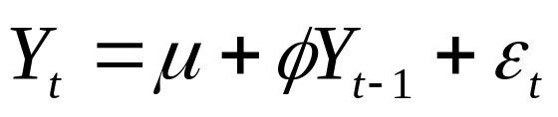
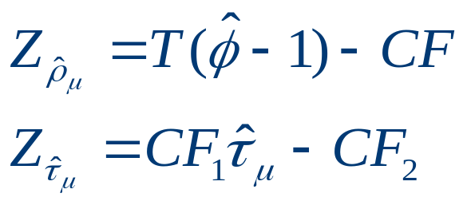
4. Other Unit Root Tests: i. Phillips-Perron Test (PP)
DF: ε_{t} ~ iid
PP: ε_{t} ~ serially correlated
Add a correction factor to the DF test stat.
(ADF is to add lagged ΔY_{t} to ‘whiten’ the serially correlated residuals)

Slide 6
Problem of PP test
On the one hand, the PP tests tend to be more powerful but, on the other hand, also subject to more severe size distortions
  Size problem: actual size is larger than the nominal one when autocorrelations of ε_{t} are negative
  more sensitive to model misspecification (the order of autoregressive and moving average components).
Plotting ACFs help us to detect the potential size problem
  Economic time series sometimes have negative autocorrelations especially at lag one, we can use a Monte Carlo analysis to simulate the appropriate critical values, which may not be attractive to do.

Slide 7
Criticism of Dickey-Fuller and
Phillips-Perron-type tests
Main criticism is that the power of the tests is low if the process is stationary but with a root close to the non-stationary boundary.
e.g. the tests are poor at deciding if
φ=1 or φ=0.95,
especially with small sample sizes.
If the true data generating process (DGP) is
y_{t} = 0.95y_{t-1} + u_{t}
then the null hypothesis of a unit root should be rejected.
One way to get around this is to use a stationarity test as well as the unit root tests we have looked at.

Slide 8
4. Other unit root tests ii. Stationarity as the null
Stationarity tests have
H₀: y_{t} is stationary
versus H₁: y_{t} is non-stationary
So that by default under the null the data will appear stationary.
One such stationarity test is the KPSS test (Kwaitowski, Phillips, Schmidt and Shin, 1992).
Kwiatkowski, D., P. C. B. Phillips, P. Schmidt and Y. Shin, (1992), “Testing the Null Hypothesis of Stationary Against the Alternative of a Unit Root,” Journal of Econometrics, 54, 159–178.
Thus we can compare the results of these tests with the ADF/PP procedure to see if we obtain the same conclusion.

Slide 9
4. Other unit root tests ii. Stationarity as the null
A Comparison
ADF / PP KPSS
H₀: y_{t} ∼ I(1) H₀: y_{t} ∼ I(0)
H₁: y_{t} ∼ I(0) H₁: y_{t} ∼ I(1)
4 possible outcomes
a. Reject H₀ and Do not reject H₀
b. Do not reject H₀ and Reject H₀
c. Reject H₀ and Reject H₀
d. Do not reject H₀ and Do not reject H₀

Slide 10
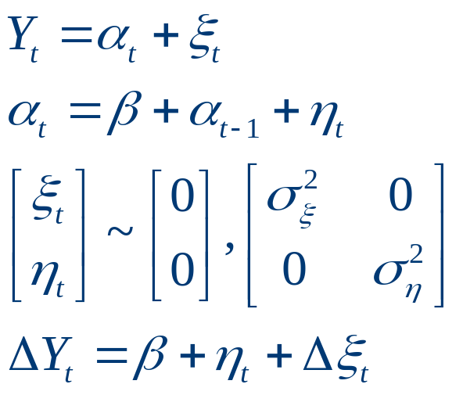
4. Other unit root tests ii. Stationarity as the null
Structural time-series models: treat the observed series as the sum of a I(0) and a I(1) component:
Local level model
KPSS test: equations 7.48 and 7.49, pp. 269.

Slide 11
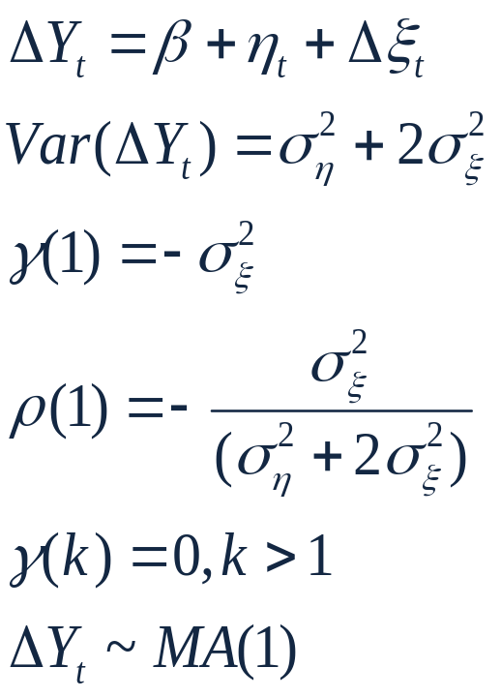
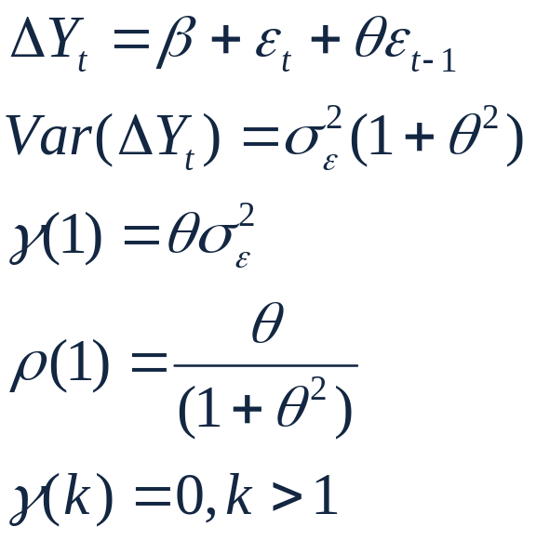
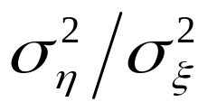
4. Other unit root tests ii. Stationarity as the null
Structural model:
Reduced form:
Solve θ in terms of the signal-to-noise ratio: q=

Slide 12
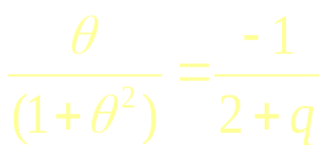
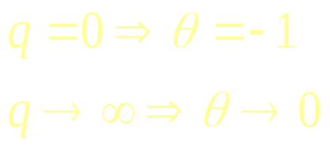
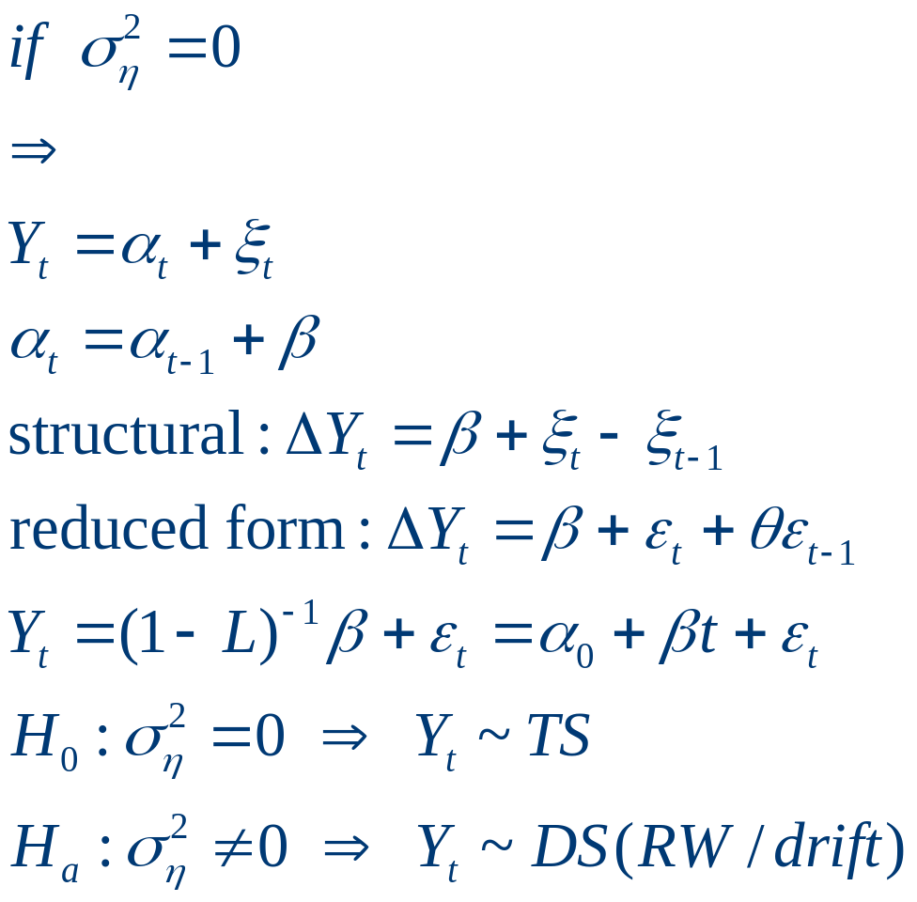
Testing the null that the variance of the I(1) component is zero.

Slide 13
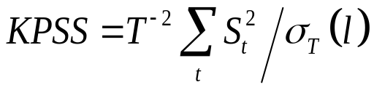
4. Other unit root tests ii. Stationarity as the null: KPSS test
1. Regress y_{t} on a constant and trend; construct the OLS residuals, e =[e₁, …,e_{T}]’
2. S_{t} = ∑^{t}_{i=1} e_{i}; the partial sum of the residuals
3. Test statistic:
σ_{T} (l) represents an estimate of the long run variance of the residuals.
We reject the stationary null when KPSS is large, since that is evidence that the series wanders from its mean.
As with unit root test, KPSS must be modified if v_{t} is serially correlated.

Slide 14
4. Other unit root tests iii. Structural breaks
A stationary time-series may look like nonstationary when there are structural breaks in the intercept or trend
The unit root tests lead to false nonrejection of the null when we don’t consider the structural breaks → low power
A single breakpoint is introduced in Perron (1989) into the regression model; Perron (1997) extended it to a case of unknown breakpoint
Perron, P., (1989), “The Great Crash, the Oil Price Shock and the Unit Root Hypothesis,” Econometrica, 57, 1361–1401.

Slide 15
4. Other unit root tests iii. Structural breaks
1. Consider the null and alternative hypotheses
H₀: y_{t} = a₀ + y_{t-1} + µ₁D_{P} + ε_{t}
H_{A}: y_{t} = a₀ + a₂t + µ₂D_{L} + ε_{t}
  Pulse break: D_{P} = 1 if t = T_{B} + 1 and zero otherwise,
  Level break: D_{L} = 0 for t = 1, . . . , T_{B} and one otherwise.
Null: y_{t} contains a unit root with a one–time jump in the level of the series at time t = T_{B} + 1 .
Alternative: y_{t} is trend stationary with a one–time jump in the intercept at time t = T_{B} + 1 .

Slide 16
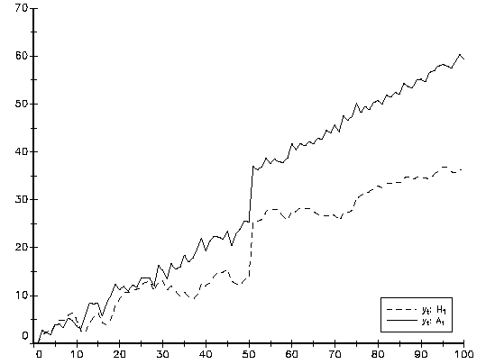
Simulated unit root and trend stationary processes with structural break.
T= 100
ε_{t} ~ i.i.d. N(0,1)
y₀=0
H₀: ------
a₀ = 0.5,
D_{P} = 1 for t = 51 zero otherwise,
µ₁ = 10.
H_{A}:
a₂ = 0.5,
D_{L} = 1 for t > 50.
µ₂ = 10

Slide 17
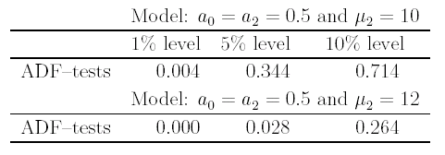
Power of ADF tests: Rejection frequencies of ADF–tests
.
ADF tests are biased toward nonrejection of the null
Rejection frequency is inversely related to the magnitude of the shift.
Perron: estimated values of the autoregressive parameter in the Dickey–Fuller regression was biased toward unity and that this bias increased as the magnitude of the break increased

Slide 18
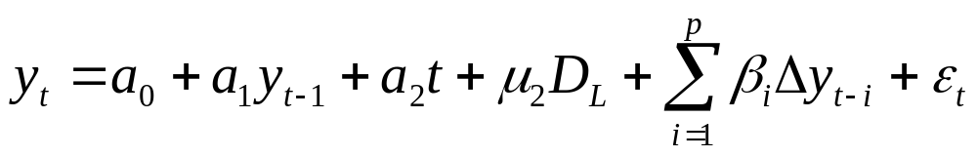
Testing for unit roots when there are structural changes
Perron suggests running the following OLS regression:
H₀: a₁ = 1; t–ratio, DF unit root test.
Perron shows that the asymptotic distribution of the t-statistic depends on the location of the structural break, λ= T_{B}/T
  critical values are supplied in Perron (1989) for different assumptions about λ, see Table IV.B.

